Slide 1
Personal Software ProcessSM
for Engineers: Part II
Software Quality

Slide 2
Lecture Topics
What is quality?
The economics of quality
Defect-removal methods
Design and code reviews
Quality measures
Review considerations

Slide 3
What is Quality?
Basic definition: meeting the users’ needs
  needs, not wants
  true functional needs are often unknowable
There is a hierarchy of needs.
  Do the required tasks.
  Meet performance requirements.
  Be usable and convenient.
  Be economical and timely.
  Be dependable and reliable.

Slide 4
The PSP Quality Focus -1
To be useful, software must
  install quickly and easily
  run consistently
  properly handle normal and abnormal cases
  not do destructive or unexpected things
  be essentially bug-free
Defects are not important to users, as long as they do not
  affect operations
  cause inconvenience
  cost time or money
  cause loss of confidence in the program’s results

Slide 5
The PSP Quality Focus -2
The defect content of software products must be managed before more important quality issues can be addressed.
Low defect content is an essential prerequisite to a quality software process.
Since low defect content can best be achieved where the defects are injected, engineers should
  remove their own defects
  determine the causes of their defects
  learn to prevent those defects

Slide 6
The Economics of Quality
Software is the only modern technology that relies on testing to manage quality.
With common quality practices, software groups typically
  spend 50+% of the schedule in test
  devote more than half their resources to fixing defects
  cannot predict when they will finish
  deliver poor-quality and over-cost products
To manage cost and schedule, you must manage quality.
To get a quality product out of test, you must put a quality product into test.
Notes:
Watts comment: validate a program’s functionality and properties

Slide 7
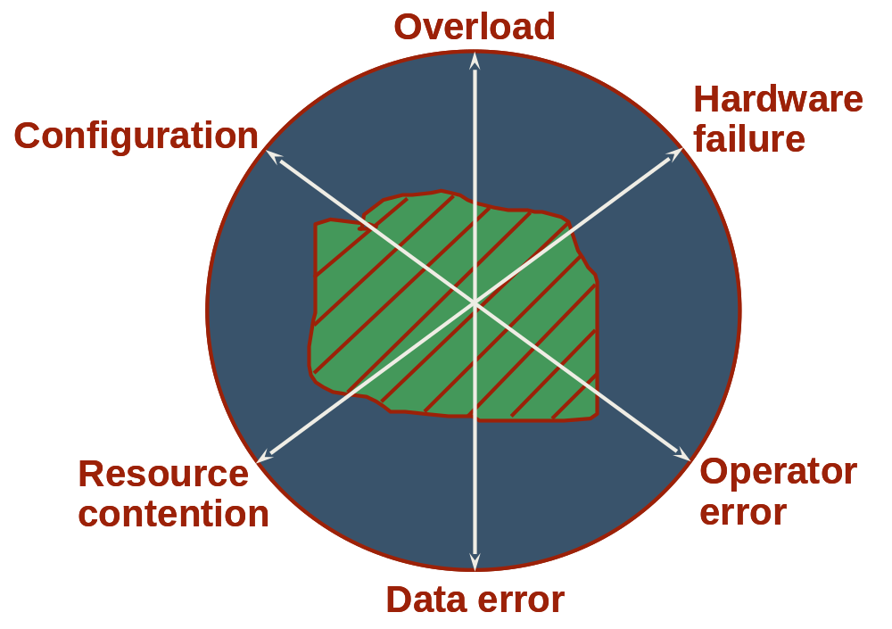
Testing Alone is Ineffective
Safe and secure
region = tested
(shaded)
Unsafe and insecure
region = untested
(unshaded)
Notes:
Disciplined processes use reviews and inspections to clear the entire “mine field.”
Use examples of why the boundary conditions are the most important.
Air traffic control landing all planes on 9/11/01
Nuclear Regulatory Commission – everything goes wrong at the same time
Extreme cases are the one you run into and need the system to work.

Slide 8
Removing Defects in Test
When performing a task thousands of times, economics would suggest that you use the most efficient methods.
A 50,000 LOC system with traditional development methods would
  have 25+ defects/KLOC at test entry - 1250 defects
  take 12,500+ programmer hours to test
  be late and over budget
At the typical rate of 10+ hours per defect, this is 6 programmer years.

Slide 9
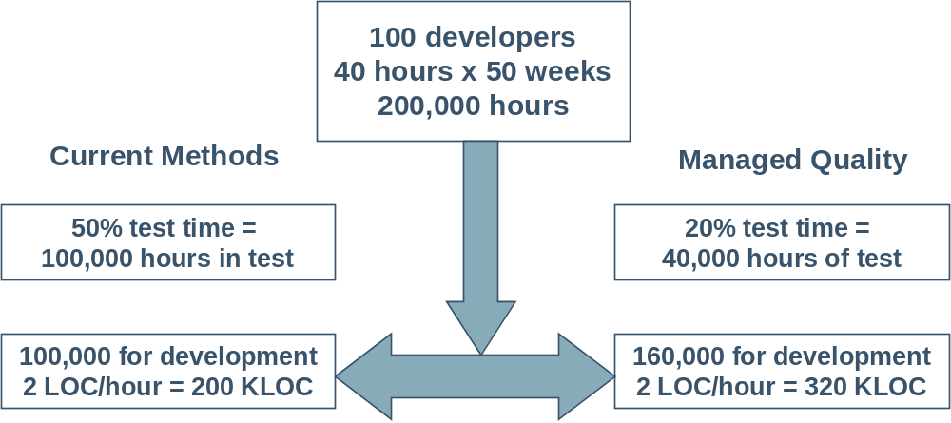
Quality and Productivity
Managed quality = 60% increased team productivity

Slide 10
Defect-removal Methods -1
The principal ways to find and fix defects are by
  compiling
  unit testing
  integration and system testing
  team inspections
  personal reviews
Since you will likely have to remove lots of defects, you should use the most efficient methods.

Slide 11
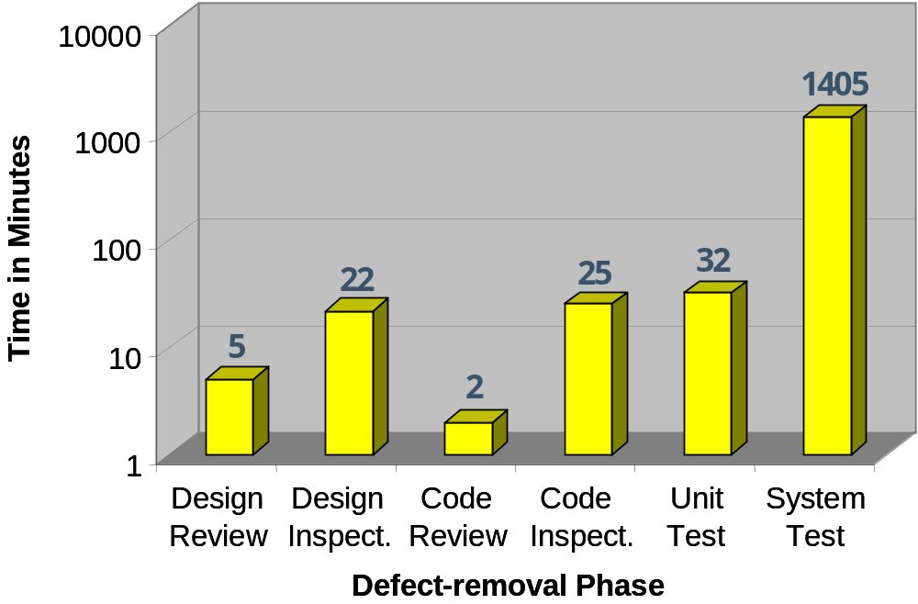
Defect-removal Times
Source: Xerox
Notes:
MPH comment: completely changed format of this graph so that the filled white box behind the graph is gone; title has been moved to correct placement and changed to be consistent with slide master format.

Slide 12
Defect-removal Methods -2
In a personal review
  you privately review your product
  your objective is to find and fix defects before test
Reviews are most effective when they are structured and measured.
Use reviews for requirements, designs, code, and everything else that you develop.
Also continue to use inspections, compiling, and testing.

Slide 13
Defect-removal Rates -1
Even at the personal level, it is more efficient to find defects in reviews than in testing.
  Unit test finds only about 2 to 4 defects per hour.
  Unit test finds about 50% of the defects.
  Code reviews find about 6 to 10 defects per hour.
  Practiced reviewers can find 70% or more of the defects before compiling or testing.

Slide 14
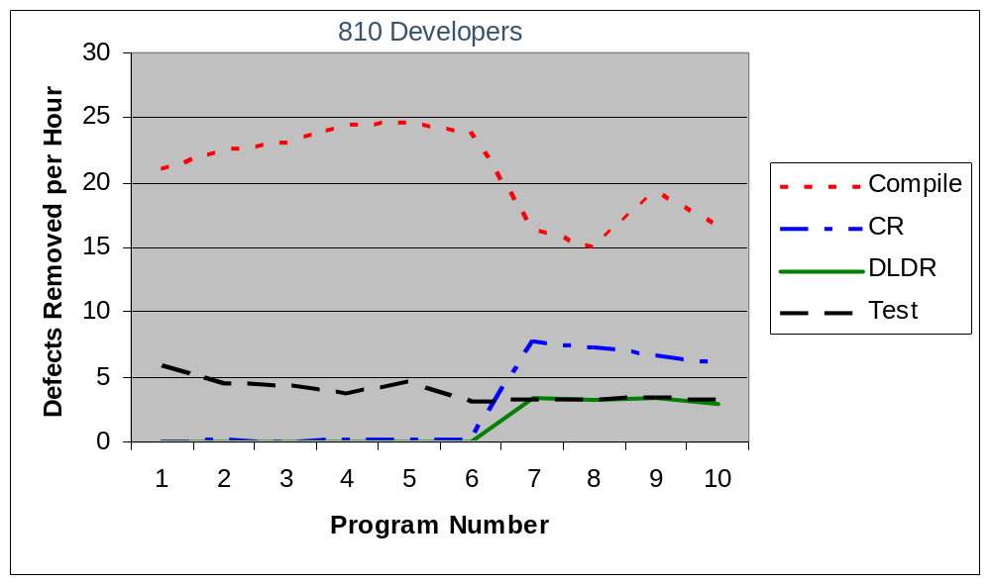
Defect-removal Rates -2

Slide 15
Why Reviews are Efficient
In testing, you must
  detect unusual behavior
  figure out what the test program was doing
  find where the problem is in the program
  figure out which defect could cause such behavior
This can take a lot of time.
With reviews and inspections, you
  follow your own logic
  know where you are when you find a defect
  know what the program should do, but did not
  know why this is a defect
  are in a better position to devise a correct fix

Slide 16
Review Principles
PSP reviews follow a defined process with guidelines, checklists, and standards.
The PSP review goal is to find every defect before the first compile or test.
To address this goal, you should
  review before compiling or testing
  use coding standards
  use design completeness criteria
  measure and improve your review process
  use a customized personal checklist

Slide 17
The Code Review Checklist
Your reviews will be most effective when your personal checklist is customized to your own defect experience.
  Use your own data to select the checklist items.
  Gather and analyze data on the reviews.
  Adjust the checklist with experience.
Do the reviews on a printed listing, not on the screen.
The checklist defines the review steps and the suggested order for performing them.
Review for one checklist item at a time.
Check off each item as you complete it.

Slide 18
Design Review Principles
In addition to reviewing code, your should also review your designs.
This requires that you
produce designs that can be reviewed
follow an explicit review strategy
review the design in stages
verify that the logic correctly implements the
requirements

Slide 19
Reviewable Designs
A reviewable design has a
  defined context
  precise representation
  consistent and clear structure
This suggests that
  the design’s purpose and function be explicitly stated
  you have criteria for design completeness
  the design is structured in logical elements
These design topics are covered in the next two lectures.

Slide 20
The Design Review Strategy
Produce designs that can be reviewed in stages.
The suggested review stages are as follows.
1. Review against the requirements to ensure that each required function is addressed by the design.
2. Verify the overall program structure and flow.
3. Check the logical constructs for correctness.
4. Check for robustness, safety, and security.
5. Check the function, method, and procedure calls to ensure proper use.
6. Check special variables, parameters, types, and files for proper use.

Slide 21
Quality Measures
To do efficient reviews, you must have measures.
The PSP has many useful quality and process-control measures.
  yield
  review rate
  defects found per unit of size
  defects injected and removed per hour
  defect-removal leverage
  cost of quality (COQ)

Slide 22
Phase Yield
Phase yield measures the
  percentage of the defects in the product that were found by that phase
  defect-removal effectiveness of that process step
Yield can be used to measure the effectiveness of design and code reviews, inspections, compiling, and testing.
Yield (for a phase) =
100 * (defects found) / (defects found + not found)

Slide 23
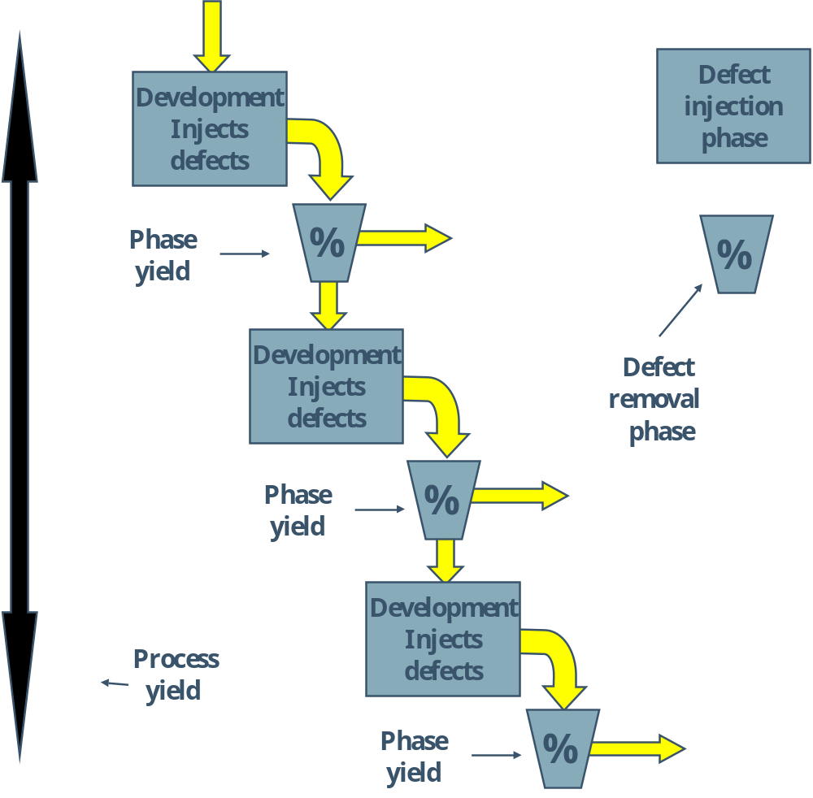
Defect-Removal Filters

Slide 24
Process Yield
Process yield is the percentage of defects injected before a phase that were found before that phase.
For example, yield before system test is the system test process yield.
When used without a phase name, process yield refers to the phase yield before compile and test.

Slide 25
Yield Estimates
Yield can be estimated but not precisely calculated until all defects have been found through test and product use.
Yield measures are most useful when the developers and testers record all of the defects.
  design and code review defects
  compile defects
  test defects
By using process-control measures, you are more likely to do high-yield reviews.

Slide 26
Potential Control Parameters
To be useful, process control measures must be available during the process. Examples are
  size units reviewed per hour
  defects found per hour
  defects found per size unit
While no control parameter directly correlates with phase yield, review rate is the most useful control parameter.
Review rate is the parameter used in the PSP.

Slide 27
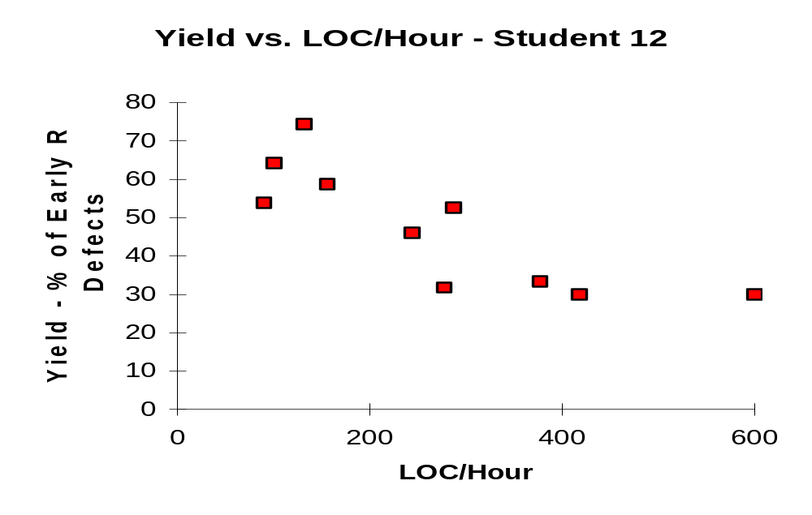
Yield versus Review Rate -1

Slide 28
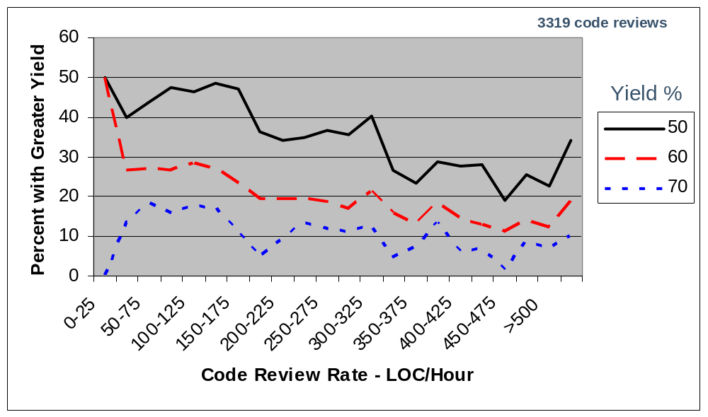
Yield versus Review Rate -2

Slide 29
Yield versus Review Rate -3
While there is considerable variation, higher rates generally give lower-yield reviews.
The PSP suggests the following upper limits for review rates:
  code (using the LOC measure): 200 LOC/hour
  documents: 4 pages/hour
  other measures: develop from your personal review data

Slide 30
Defect Removal Leverage (DRL)
DRL measures the relative effectiveness of a process step at removing defects.
DRL is the number of defects removed per hour by a process step relative to a base process.
  The usual base is unit test (UT).
  DRL (X/UT) is the DRL for phase X with respect to unit test.
DRL is calculated as
DRL(X/UT) = (defects/hour phase X) / (defects/hour unit test)

Slide 31
Cost of Quality (COQ) -1
COQ measure process quality in a way that is meaningful to management.
The COQ elements are failure, appraisal, and prevention costs.
Failure cost is the time spent in repair and rework plus the cost of any scrap. In PSP, it is compile and test time.
Appraisal costs are the costs of inspecting for defects. In PSP, appraisal cost is design and code review time.
In the TSP, inspections are included in appraisal costs.

Slide 32
Cost of Quality (COQ) -2
Defect-prevention cost is the cost of identifying and resolving defect causes.
Defect prevention generally is done by a team or a group and usually is led by a support staff member.
Other defect-prevention costs are
  formal specification and design work
  prototyping
  process analysis and improvement
  defect recording

Slide 33
Cost of Quality (COQ) -3
A useful COQ measure is the ratio of appraisal to failure costs (A/FR). This is
A/FR = (appraisal COQ) / (failure COQ)
A/FR experience
  A/FR measures are sensitive to the project.
  For the PSP exercises, the A/FR target is 2.0 or greater.
  High A/FR is associated with low numbers of test defects and high product quality.
  Projects should set A/FR targets based on estimated defect-free test times.

Slide 34
Review Considerations
Reviewing before or after compile
The relationship of reviews and inspections
Defect prevention

Slide 35
Reviewing Before Compile
When your development environment has a compile step, it is more efficient to do code reviews before compiling.
The reasons for this are as follows
  Review time is about the same before or after compiling.
  If reviews are done before compiling, compile time is substantially reduced.
  The time saved in compiling and testing is often more than the review time.
  Code reviews find syntax/typo defects that the compiler would miss.
  Code reviews of compiled code are less effective.
  The compiler is equally effective before or after a review.
  Programs with many compile defects often have many test defects.

Slide 36
Compile vs. Test Defects - Student 20
10
9
8
7
6
Test Defects
5
4
3
2
1
0
0
10
20
30
40
50
Compile Defects

Slide 37
Compile vs. Test Defects - Student 1
10
9
8
7
6
Test Defects
5
4
3
2
1
0
0
5
10
15
20
Compile Defects

Slide 38
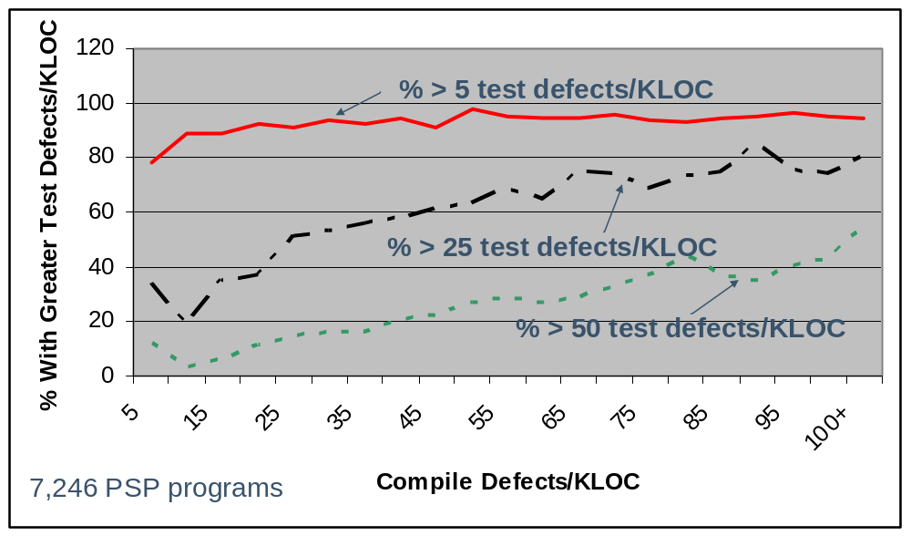
Test vs. Compile Defects/KLOC

Slide 39
Reviews and Inspections
The principal focus of inspections should be to find problems that you have missed.
When programs have many simple defects, inspectors are distracted and often miss more important problems.
Reviewing the code first
  provides a quality product for the inspection
  shows respect for the inspectors’ time
  produces higher-quality inspections
  produces higher-quality products

Slide 40
Defect Prevention
Defect prevention is important because
  it is always expensive to find defects
  if the defects can be prevented, you can avoid the costs of finding and fixing them
  defect prevention analysis costs are incurred once, but the savings apply to every project
Defect prevention should follow an orderly strategy and a defined process.
For the PSP, defect prevention actions include gathering defect data, improving design methods, and prototyping.

Slide 41
Defect Prevention Strategy -1
Set priorities for the defect types that are most
  frequently found
  troublesome
  easily prevented
  annoying
The defect-prevention process has the following steps.
  Follow an established schedule.
  Select one or two defect types for initial action.
  Measure the effectiveness of defect prevention.
  Make adjustments and continue.

Slide 42
Defect Prevention Strategy -2
When setting initial priorities, consider the defect types found most frequently in integration and system test.
Use PSP data to pick one or two defect types for initial action.
Don’t just try harder; establish explicit prevention actions.
Incorporate these actions into your process scripts, checklists, and forms.

Slide 43
Messages to Remember
Improve product quality and accelerate development work by
  doing reviews and inspections to remove defects before test
  using testing to check product quality, not to remove volumes of defects
Design and code reviews
  improve the quality of your programs
  save development time
To do effective reviews, you must
  establish review goals
  follow a disciplined review process
  measure and improve your review practices

